Slide 1
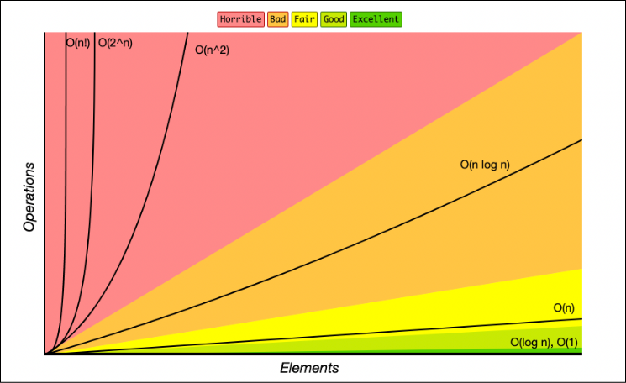
Time Complexity
Time complexity is a computational complexity that describes the amount of time it takes to run an algorithm as a function of the length of the input.
It gives an upper bound on the time requirements and helps in comparing the efficiency of different algorithms.
1

Slide 2
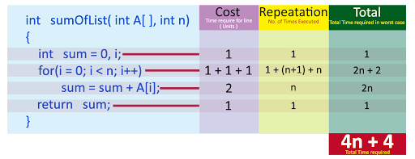
EXAMPLE
2

Slide 3
Mathematical Analysis of Algorithms
Recursive Algorithms
Involves breaking down a problem into smaller, similar subproblems, and solving them recursively. The time complexity is often expressed using recurrence relations.
Non-Recursive Algorithms
Solved using loops, iterations, or other sequential operations. Analyzing the number of operations performed in each loop gives us the time complexity.
3

Slide 4
Searching and Sorting
Searching
The process of finding a specific element within a dataset. Common algorithms include linear search and binary search.
Sorting
The process of arranging elements in a dataset in a specific order, such as ascending or descending. Examples include bubble sort, insertion sort, and quick sort.
4

Slide 5
Binary Search
Binary Search is one of the fastest searching algorithms.
It is used for finding the location of an element in a linear array.
It works on the principle of divide and conquer technique.
Binary Search Algorithm can be applied only on Sorted arrays.
In each iteration or in each recursive call, the search gets reduced to
half of the array.So for n elements in the array, there are log2n
iterations or recursive calls
17

Slide 6
Time Complexity of Binary Search Algorithm is O(log2n).
Here, n is the number of elements in the sorted linear array.
This time complexity of binary search remains unchanged irrespective of the element position even if it is not present in the array.
18

Slide 7
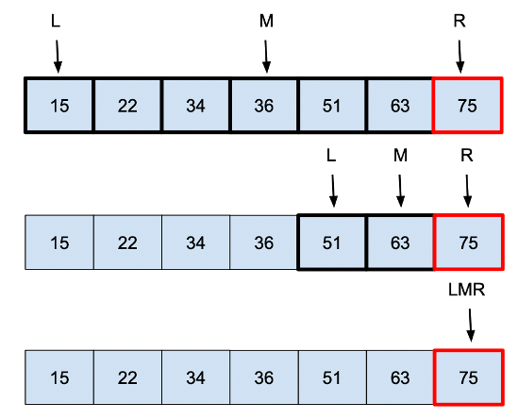
19

Slide 8
Bubble Sort
Bubble Sort is the simplest sorting algorithm that works by repeatedly swapping the adjacent elements if they are in the wrong order
Bubble sort works on the repeatedly swapping of adjacent elements until they are not in the intended order.
5

Slide 9

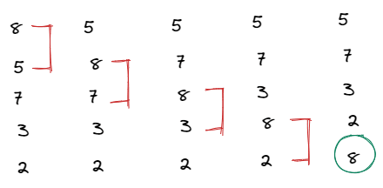
FIRST PASS
8 is the first element, so we have to compare it with all the elements that are left. Each time 8 is greater than the element after it they are swapped and so on. We use the bubble sort algorithm, On the first pass, the highest value (or lowest, depending on the sort order) is moved to the top of the list, here 8 is at the top of the list.

Slide 10
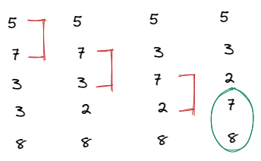
SECOND PASS
The same process continues for the second lap and 7 will never be compared with 8 because 8 is already sorted and this condition l -1 -i in the nested loop avoids making unuseful comparisons.

Slide 11
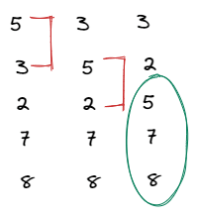
THIRD PASS

Slide 12
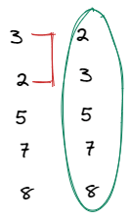
FOURTH PASS

Slide 13
The Complexity of the Bubble Sort Algorithm
Bubble sort employs two loops: an inner loop and an outer loop.
The inner loop performs O(n) comparisons deterministically.
Worst Case
In the worst-case scenario, the outer loop runs O(n) times.
As a result, the worst-case time complexity of bubble sort is O(n x n) = O(n x n) (n2).
9

Slide 14
Best Case
In the best-case scenario, the array is already sorted, but just in case, bubble sort performs O(n) comparisons.
As a result, the time complexity of bubble sort in the best-case scenario is O(n).
Average Case
Bubble sort may require (n/2) passes and O(n) comparisons for each pass in the average case.
As a result, the average case time complexity of bubble sort is O(n/2 x n) = O(n/2 x n) = O(n/2 x n) = O(n/2 x n) = O (n2).

Slide 15
Insertion Sort
Insertion sort is a simple sorting algorithm that works by iteratively inserting each element of an unsorted list into its correct position in a sorted portion of the list.
Insertion sort is like sorting playing cards in your hands.
10

Slide 16
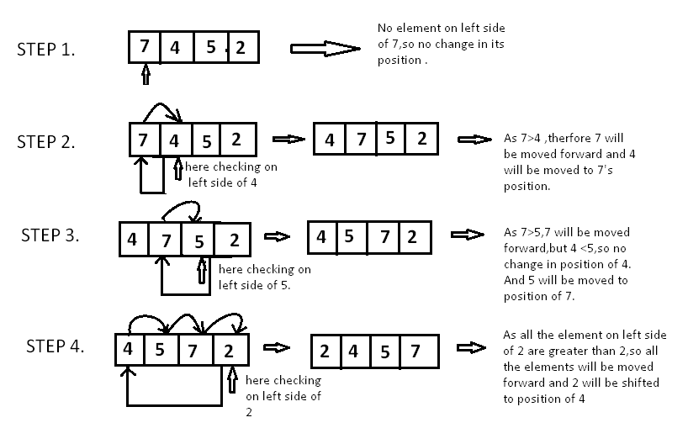
11

Slide 17
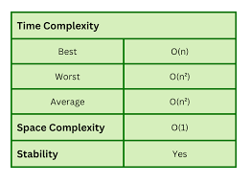
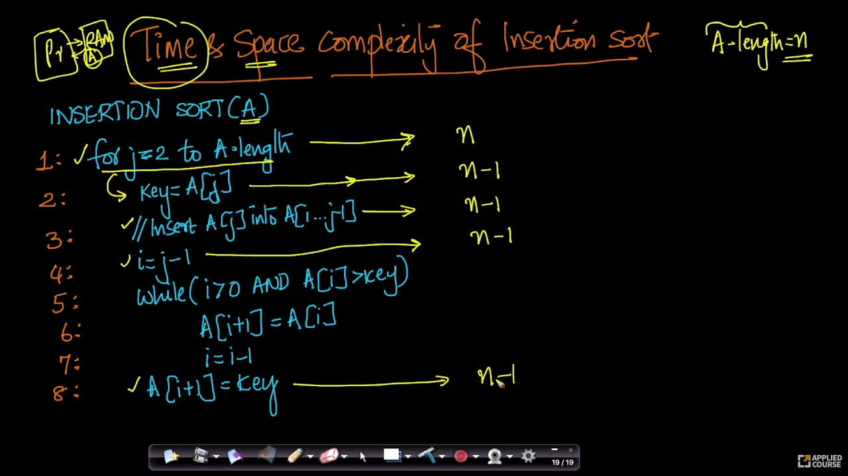
12

Slide 18
Selection Sort
In selection sort, the smallest value among the unsorted elements of the array is selected in every pass and inserted to its appropriate position into the array.
The average and worst-case complexity of selection sort is O(n²), where n is the number of items. Due to this, it is not suitable for large data sets.
13

Slide 19
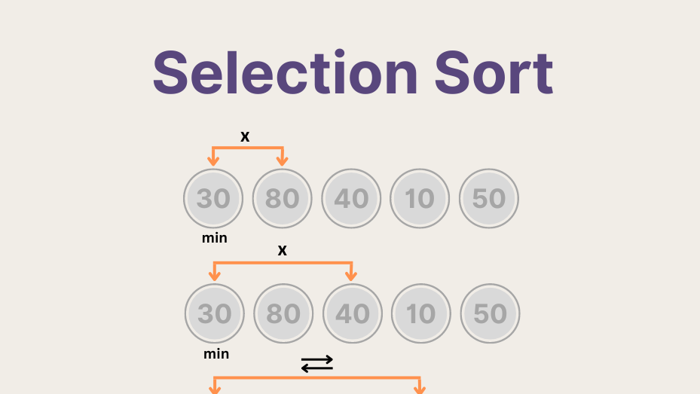
14

Slide 20
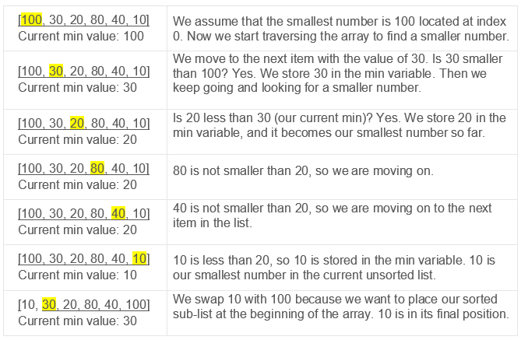
15

Slide 21
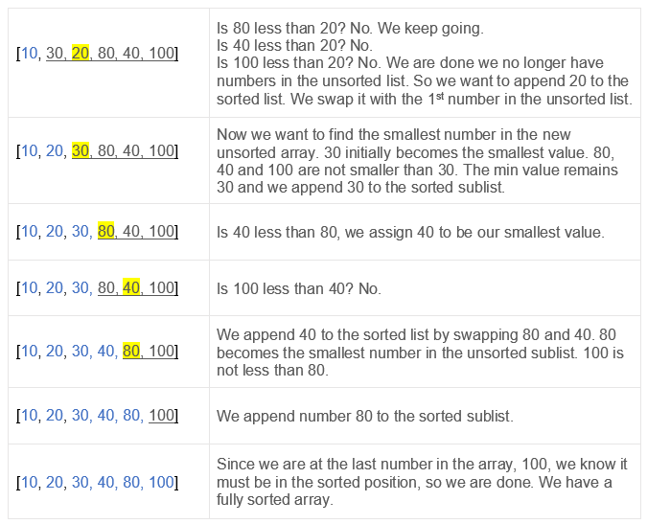
16

Slide 22
Time complexity
Best-case: O(n²), best case occurs when the array is already sorted. (where n is the number of integers in an array)
Average-case: O(n²), the average case arises when the elements of the array are in a disordered or random order, without a clear ascending or descending pattern.
Worst-case: O(n²), The worst-case scenario arises when we need to sort an array in ascending order, but the array is initially in descending order.

Slide 23
Quick Sort
Quick Sort is a divide-and-conquer algorithm like the Merge Sort.
This algorithm is basically a repetition of two simple steps that are the following:
Pick a pivot and place it in its correct place in the sorted array.
Shift smaller elements(i.e. Smaller than the pivot) on the left of the pivot and larger ones to the right.
20

Slide 24
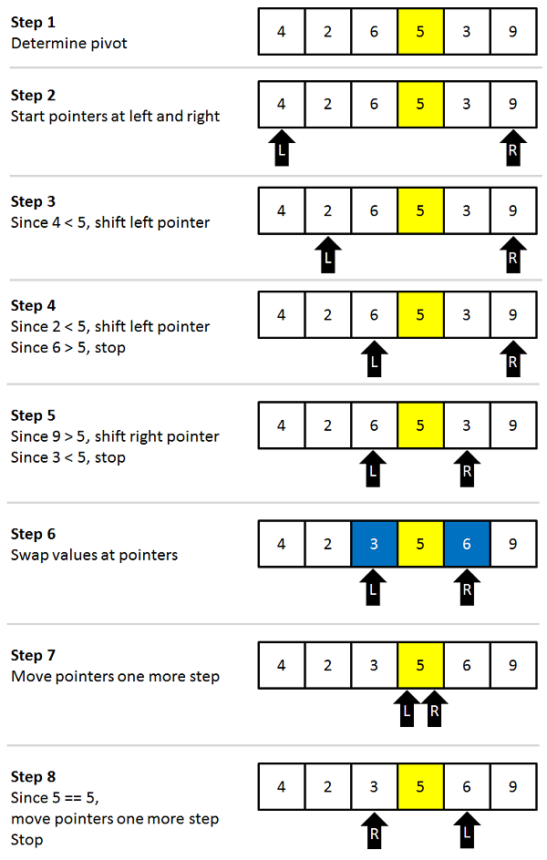
21

Slide 25
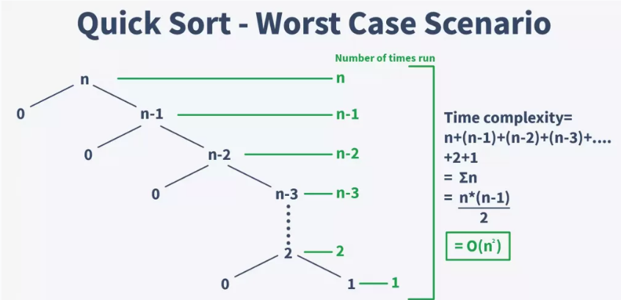
22

Slide 26
Average Case Complexity - It occurs when the array elements are in jumbled order that is not properly ascending and not properly descending. The average case time complexity of quicksort is O(n*logn).
Worst Case Complexity - In quick sort, worst case occurs when the pivot element is either greatest or smallest element. Suppose, if the pivot element is always the last element of the array, the worst case would occur when the given array is sorted already in ascending or descending order. The worst-case time complexity of quicksort is O(n²).

Slide 27
Merge Sort
Merge Sort is a divide and conquer algorithm.
It works by recursively breaking down a problem into two or more sub-problems of the same or related type, until these become simple enough to be solved directly
23

Slide 28
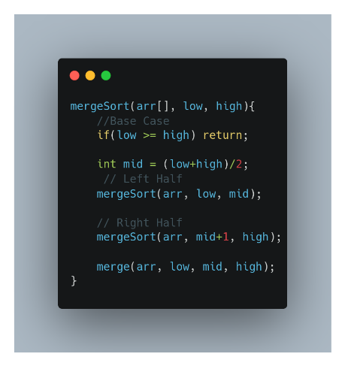
PSEUDO CODE

Slide 29
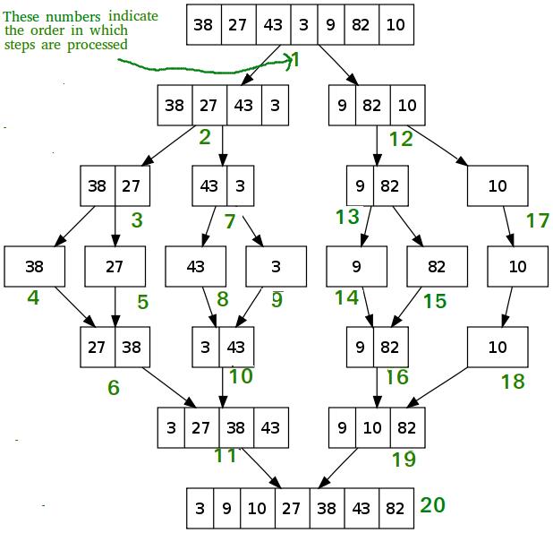
24

Slide 30
TIME COMPLEXITY
Best Case Complexity - It occurs when there is no sorting required, i.e. the array is already sorted. The best-case time complexity of merge sort is O(n*logn).
Average Case Complexity - It occurs when the array elements are in jumbled order that is not properly ascending and not properly descending. The average case time complexity of merge sort is O(n*logn).
Worst Case Complexity - It occurs when the array elements are required to be sorted in reverse order. That means suppose you have to sort the array elements in ascending order, but its elements are in descending order. The worst-case time complexity of merge sort is O(n*logn).

Slide 31
Heaps
Heaps are binary trees that maintain a specific order, either in ascending or descending order. They are used for efficient priority queues, sorting, and other operations.
Types of Heaps
There are two main types of heaps:
Max Heap: The root node contains the maximum value, and the values decrease as you move down the tree.
Min Heap: The root node contains the minimum value, and the values increase as you move down the tree.
25

Slide 32
BINARY HEAP
A Binary Heap is either Min Heap or Max Heap.
In a Min Binary Heap, the key at the root must be minimum among all keys present in Binary Heap.
The same property must be recursively true for all nodes in Binary Tree.
Max Binary Heap is similar to MinHeap.
26

Slide 33
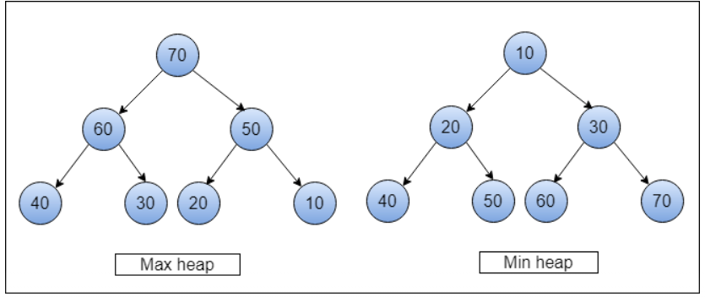

Slide 34
Heap Sort
Build Heap
1
The input array is converted into a max-heap or min-heap.
2
Extract Max/Min
The root node (max or min value) is extracted and placed at the end of the array.
Heapify
3
The heap property is restored by sifting down the new root node.
4
Repeat
Steps 2 and 3 are repeated until the entire array is sorted.
27

Slide 35
HASHING
Hashing is a fundamental data structure that efficiently stores and retrieves data in a way that allows for quick access.
It involves mapping data to a specific index in a hash table using a hash function that enables fast retrieval of information based on its key
It involves using a hash function to map data items to a fixed-size array which is called a hash table.

Slide 36
Hash Function: You provide your data items into the hash function.
Hash Code: The hash function crunches the data and give a unique hash code.
Hash Table: The hash code then points you to a specific location within the hash table.

Slide 37
HASH FUNCTION
The hash function is a function that takes a key and returns an index into the hash table. The goal of a hash function is to distribute keys evenly across the hash table, minimizing collisions (when two keys map to the same index).
Common hash functions include:
Division Method: Key % Hash Table Size
Multiplication Method: (Key * Constant) % Hash Table Size
Universal Hashing: A family of hash functions designed to minimize collisions

Slide 38
Hash Collision?
A hash collision occurs when two different keys map to the same index in a hash table. This can happen even with a good hash function, especially if the hash table is full or the keys are similar.

Slide 39
Collision Resolution Techniques
There are two types of collision resolution techniques:
Open Addressing:
Linear Probing: Search for an empty slot sequentially
Quadratic Probing: Search for an empty slot using a quadratic function
Closed Addressing:
Chaining: Store colliding keys in a linked list or binary search tree at each index

Slide 40
LINEAR PROBING
To use the linear probing algorithm, we must traverse all cells in the hash table sequentially. Inserting or searching for keys could result in a collision with a previously inserted key. Yet, with linear probing, we overcome this by searching linearly for the next available cell.

Slide 41
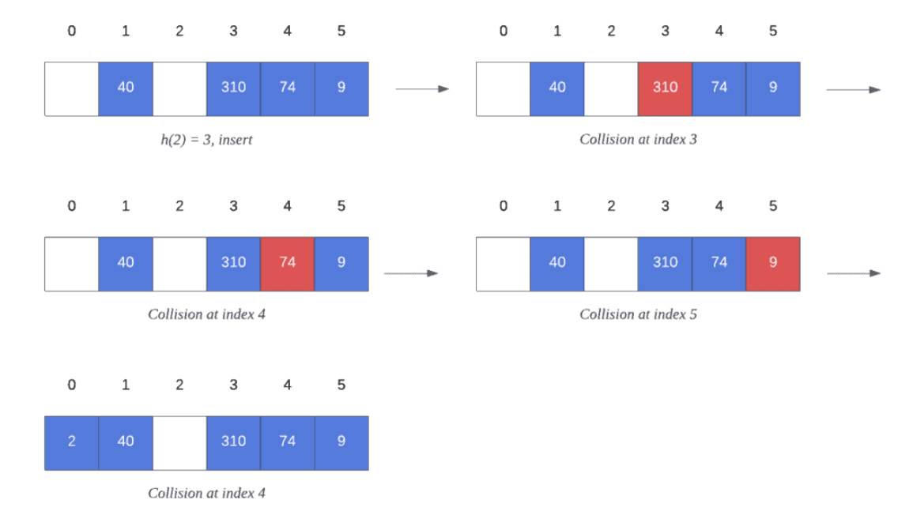

Slide 42
QUADRATIC PROBING
Quadratic Probing (QP) is a probing method which probes according to a quadratic formula, specifically:
P(x) = ax² + bx +c, where a, b, c are constants and a != 0 otherwise we will have linear probing.
However, not all quadratic functions are viable because they are unable to produce a cycle of order N. We need some way to handle this.

Slide 43
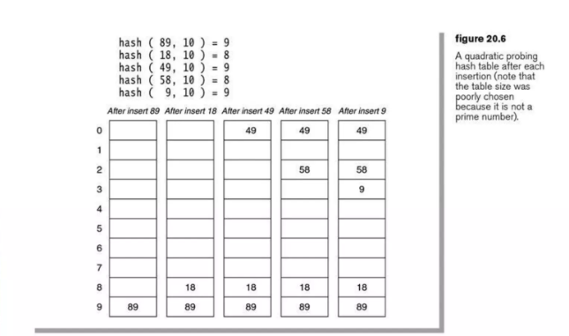
EXAMPLE

Slide 44
DOUBLE HASHING
Double hashing is a collision resolution technique used in hash tables.
It works by using two hash functions to compute two different hash values for a given key.
The first hash function is used to compute the initial hash value, and the second hash function is used to compute the step size for the probing sequence.

Slide 45
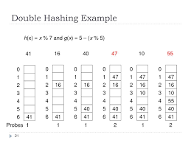
EXAMPLE

Slide 46
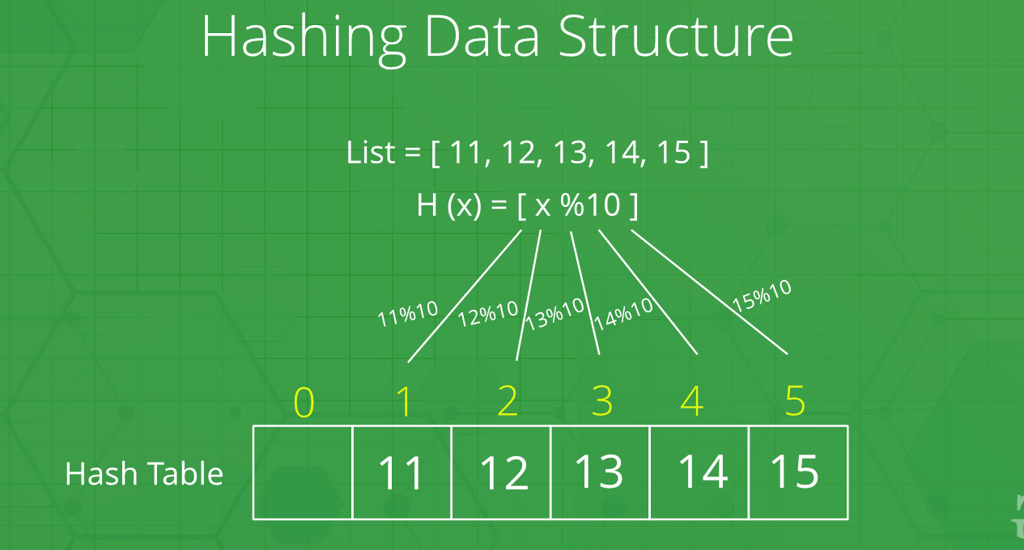

Slide 47
Greedy Algorithm
Greedy algorithms are a class of algorithms that make locally optimal choices at each step with the hope of finding a global optimum solution.
28

Slide 48
Steps for Creating a Greedy Algorithm
The steps to define a greedy algorithm are:
Define the problem: Clearly state the problem to be solved and the objective to be optimized.
Identify the greedy choice: Determine the locally optimal choice at each step based on the current state.
Make the greedy choice: Select the greedy choice and update the current state.
Repeat: Continue making greedy choices until a solution is reached.

Slide 49
Greedy Algorithm Examples
Fractional Knapsack: Optimizes the value of items that can be fractionally included in a knapsack with limited capacity.
Dijkstra’s algorithm : Finds the shortest path from a source vertex to all other vertices in a weighted graph.
Kruskal’s algorithm : Finds the minimum spanning tree of a weighted graph.
Huffman coding : Compresses data by assigning shorter codes to more frequent symbols.

Slide 50
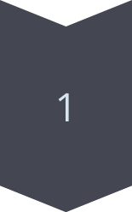
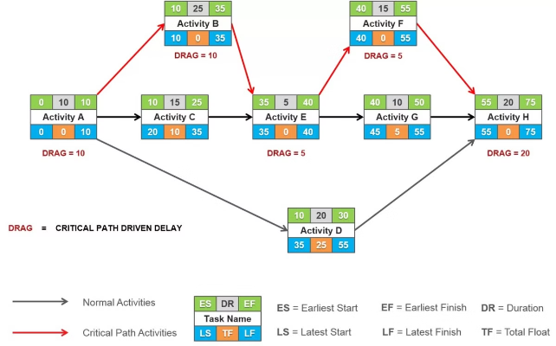
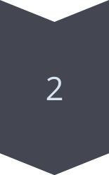
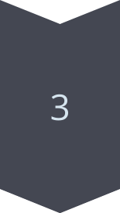
Activity Selection Problem
Sort Activities
Activities are sorted based on their
finish times.
Select First Activity
The first activity is selected,
as it has the earliest finish time.
Iterate and Select
For subsequent activities, select the activity with the earliest finish time that does not overlap with the previously selected activity.
29

Slide 51
Fractional Knapsack
The knapsack problem states that − given a set of items, holding weights and profit values, one must determine the subset of the items to be added in a knapsack such that, the total weight of the items must not exceed the limit of the knapsack and its total profit value is maximum.
It is one of the most popular problems that take greedy approach to be solved. It is called as the Fractional Knapsack Problem.
30

Slide 52
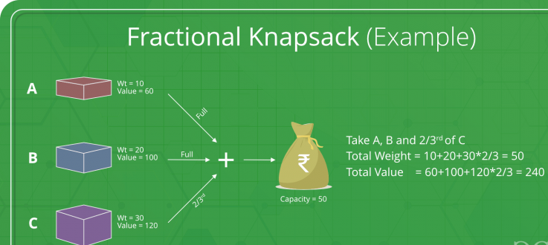

Slide 53
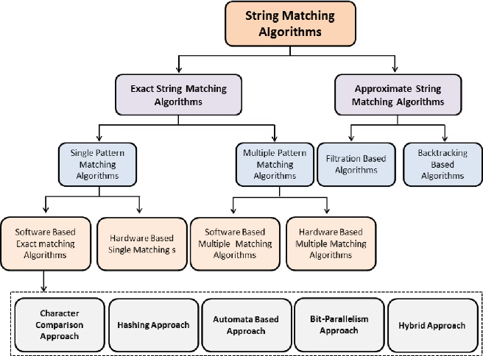
31

Slide 54
Naive Algorithm
1
Iterate String
Iterates through the entire string character by character.
2
Compare Pattern
At each position, it compares the pattern with the current
substring.
3
Match Found
If a match is found, it continues searching for other matches.
32

Slide 55
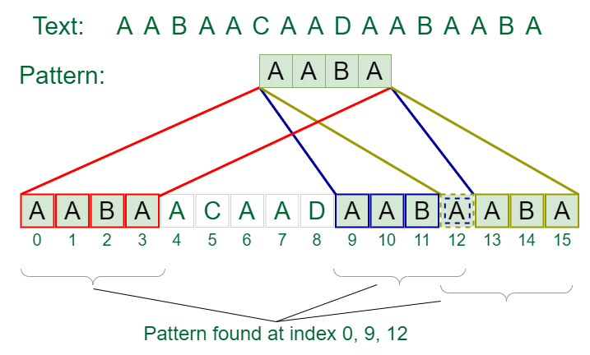
EXAMPLE

Slide 56
1
Hashing
The algorithm uses hashing to efficiently compare patterns and substrings within the text.
Rabin-Karp Algorithm
2
Rolling Hash
A rolling hash function is used to update the hash values as the pattern slides across the string, making the process more efficient.
3
Verification
After a hash match is found, the pattern is explicitly compared to the substring to ensure a true match.
33

Slide 57
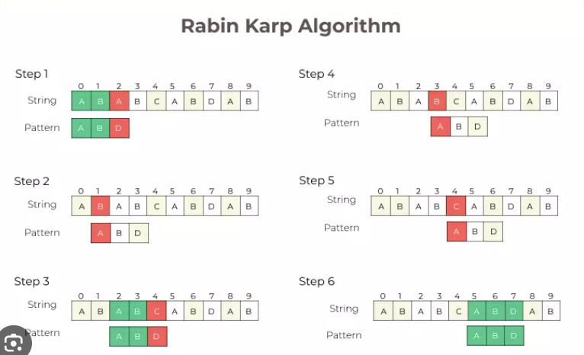

Slide 58
KMP ALGORITHM
Knuth-Morris and Pratt introduce a linear time algorithm for the string matching problem. A matching time of O (n) is achieved by avoiding comparison with an element of 'S' that have previously been involved in comparison with some element of the pattern 'p' to be matched. i.e., backtracking on the string 'S' never occurs
34

Slide 59
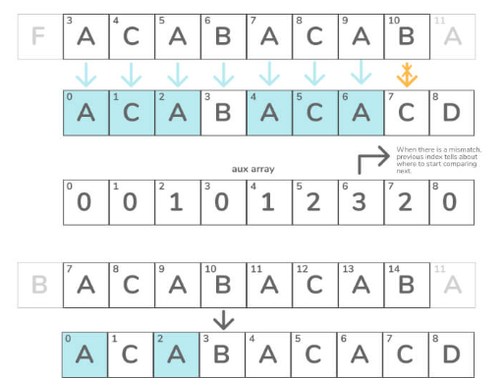
35

Slide 60
Z Algorithm
This algorithm efficiently locates all instances of a specific pattern within a text in linear time. If the length of the text is “n” and the length of the pattern is “m,” then the total time taken is O(m + n), with a linear auxiliary space.
36

Slide 61
Z ARRAY
For a string str[0..n-1], Z array is of same length as string. An element Z[i] of Z array stores length of the longest substring starting from str[i] which is also a prefix of str[0..n-1]. The first entry of Z array is meaning less as complete string is always prefix of itself.
37

Slide 62
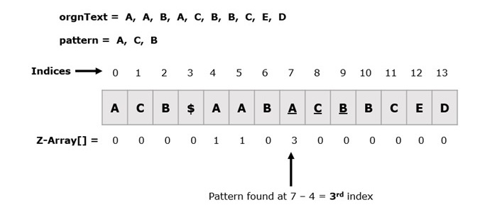

Slide 63
The idea is to concatenate pattern and text, and create a string “P$T” where P is pattern, $ is a special character should not be present in pattern and text, and T is text. Build the Z array for concatenated string. In Z array, if Z value at any point is equal to pattern length, then pattern is present at that point.

Slide 64
Manacher’s Algorithm
Manacher's Algorithm is a well-known approach for determining the longest palindromic substring within a given string.
Manacher's Algorithm is a highly effective method for identifying the longest palindromic substring within a given string. It works by taking advantage of the symmetry property of palindromes.
39

Slide 65
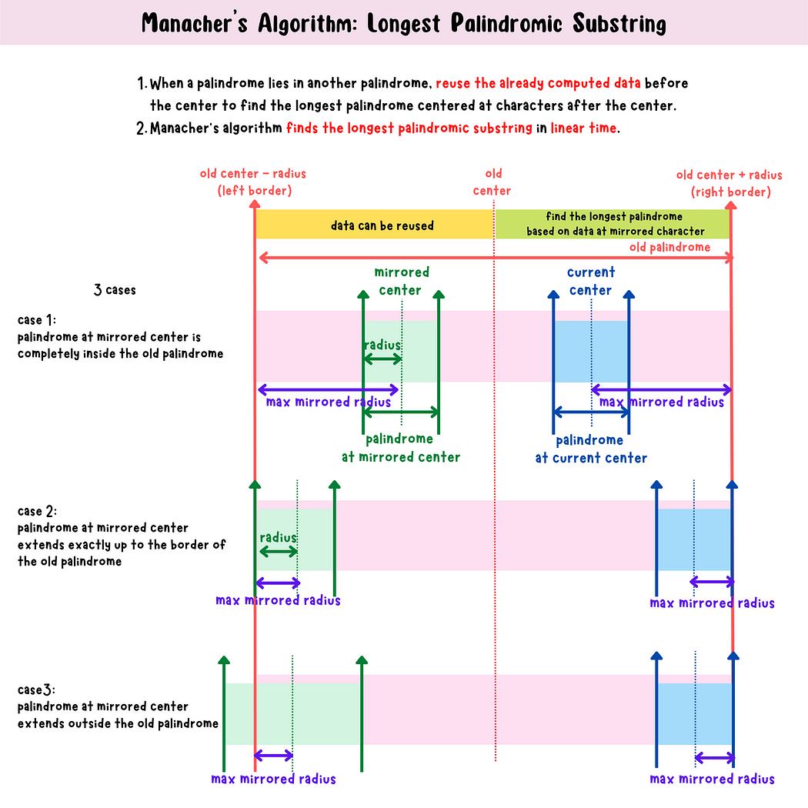

Slide 67
TIME COMPLEXITY
At the first glance, it may seem that the algorithm has a 𝑂(𝑁2)O(N2) time complexity due to nested loops, but that's not the case, a more careful analysis shows that the algorithm is linear and amortized.
Each successful comparison results in 𝑚𝑎𝑥𝑅𝑖𝑔ℎ𝑡maxRight moving one step forward, and it never reduces, therefore, the inner while loop gets executed at most 𝑛n times. Hence, the time complexity of Manacher's algorithm will be 𝑂(𝑁).O(N).

Slide 68
HUFFMAN CODING
Huffman Coding is a technique of compressing data to reduce its size without losing any of the details. It was first developed by David Huffman.
Huffman Coding is generally useful to compress the data in which there are frequently occurring characters.
40

Slide 69
ALGORITHM
Count how often each piece of data occurs.
Build a binary tree, starting with the nodes with the lowest count. The new parent node has the combined count of its child nodes.
The edge from a parent gets '0' for the left child, and '1' for the edge to the right child.
In the finished binary tree, follow the edges from the root node, adding '0' or '1' for each branch, to find the new Huffman code for each piece of data.
Create the Huffman code by converting the data, piece-by-piece, into a binary code using the binary tree.
41

Slide 70
Comparison
Algorithm
Time Complexity
Space Complexity
Applications
KMP
O(n)
O(m)
Pattern matching, text processing
Z
O(n)
O(n)
Pattern matching, text compression
Manacher's
O(n)
O(n)
Palindrome detection, text processing
Huffman
O(n log n)
O(n)
Data compression, coding
42

